Slide 1
Ratings

Slide 2
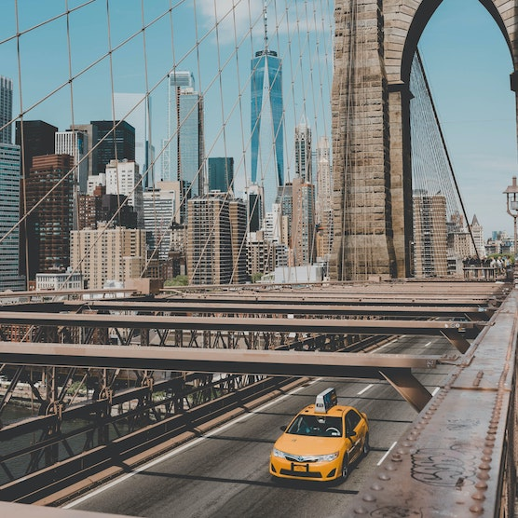


Welcome to the experiment!
Before we start, we will ask you to rate photographs according to how much you like them.
Please use the mouse to indicate your rating, as shown below.
Not at all
Very much
How much do you like this photograph?
Continue

Slide 3
Localizer

Slide 4
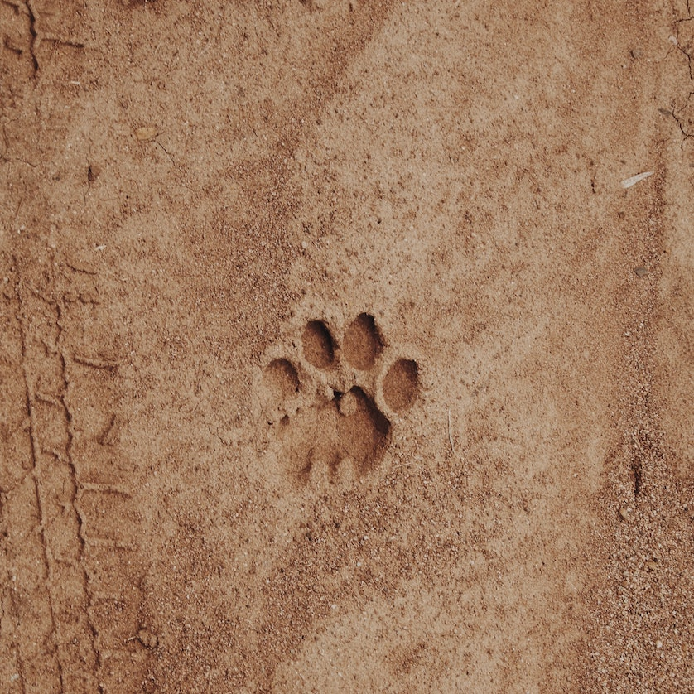
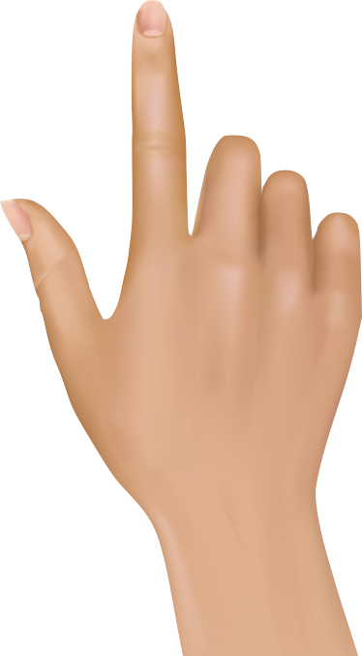
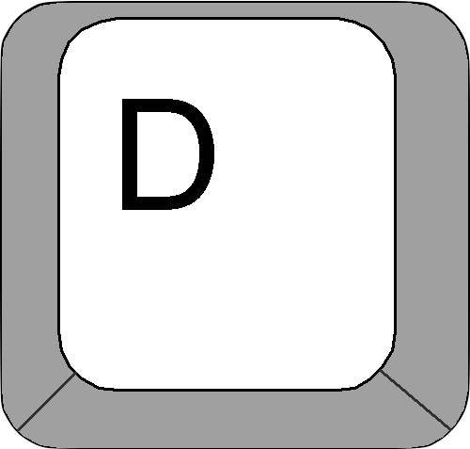
We will show you photographs, each presented very briefly.
Throughout the experiment, please place your right index finger on the “K” key, and your left index finger on the “D” key (see below).
You are asked to press the ”D” key while the photograph is on the screen.

Slide 5

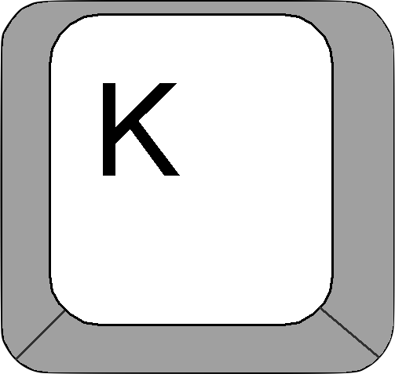
We will show you photographs, each presented very briefly.
You are asked to press the ”D” key while the photograph is on the screen.
Occasionally, there will be a red dot somewhere on top of the photograph, when this happens please press the ”K” key.
Please keep your eyes fixated at the center of the screen while the images are shown and when a “+” sign appears.
+

Slide 6
Deliberation

Slide 7
Your job in this experiment is to be an art dealer.
We will show you pairs of photographs taken by professional photographers.
In each pair, you will choose photographs for an upcoming auction.
Then the photographs will go on auction and you will find out whether you profited from each photograph or not.
Your goal should be to choose photographs that will maximize your profits.

Slide 8
Your job in this experiment is to be an art dealer.
We will show you pairs of photographs taken by professional photographers.
In each pair, you will choose photographs for an upcoming auction.
Then the photographs will go on auction and you will find out whether you profited from each photograph or not.
Your goal should be to choose photographs that will maximize your profits.
Of course, you can’t know for sure which photograph will be worth a profit later, but some things to consider might be: how it looks, how original it is, the quality of the photograph, the content of the photograph, the lighting, the layout, etc..

Slide 9
One of your decisions will be played out for real and you will earn a percentage of the auction outcome for that decision.
If the auction resulted in a gain, you will receive $1.5 as bonus payment. If it resulted in no gain, you will not receive bonus for this phase of the experiment.

Slide 10
Please take your time and consider each choice carefully.
Because these choices are important, we will give you a chance to practice making each choice a few times before you commit to your final decision.

Slide 11
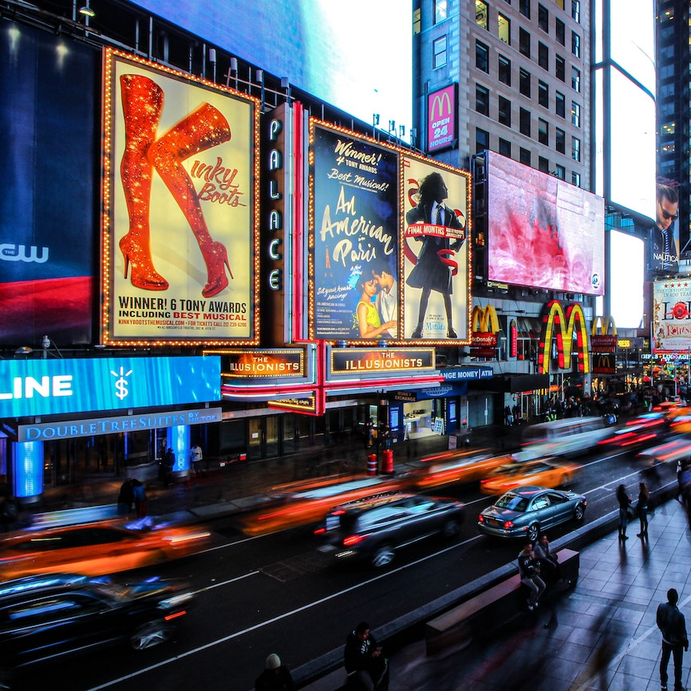
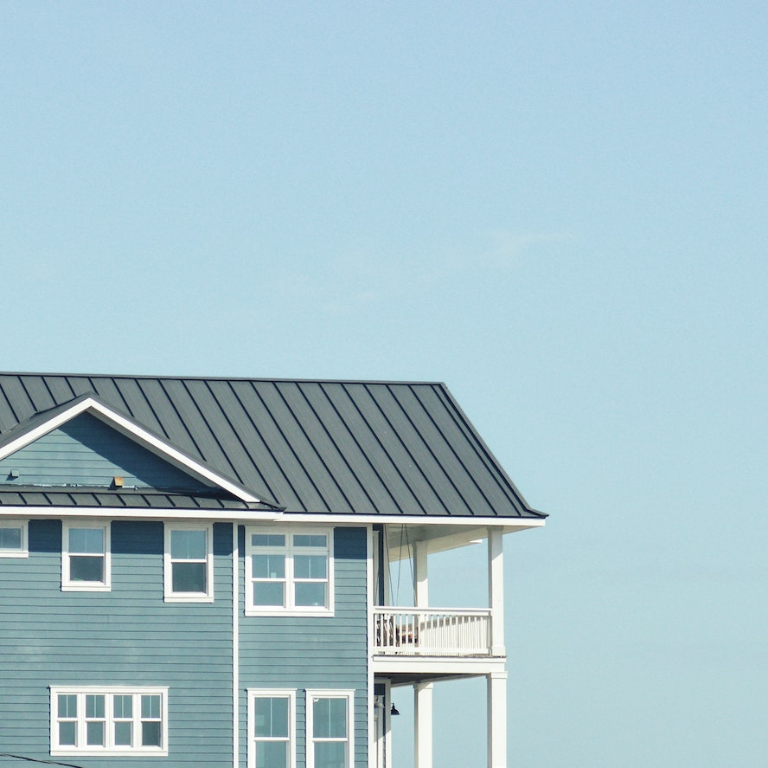
To choose the left photograph press the “D” key,
to choose the right photograph press the “K” key.
(See below an example of how the screen will look like and when you should press a button).
You will have up to 3 seconds to make your choice, giving you plenty of time to consider it carefully.
If you do not respond during the allotted time, you will see “TOO SLOW” on the screen.
+
+

Slide 12
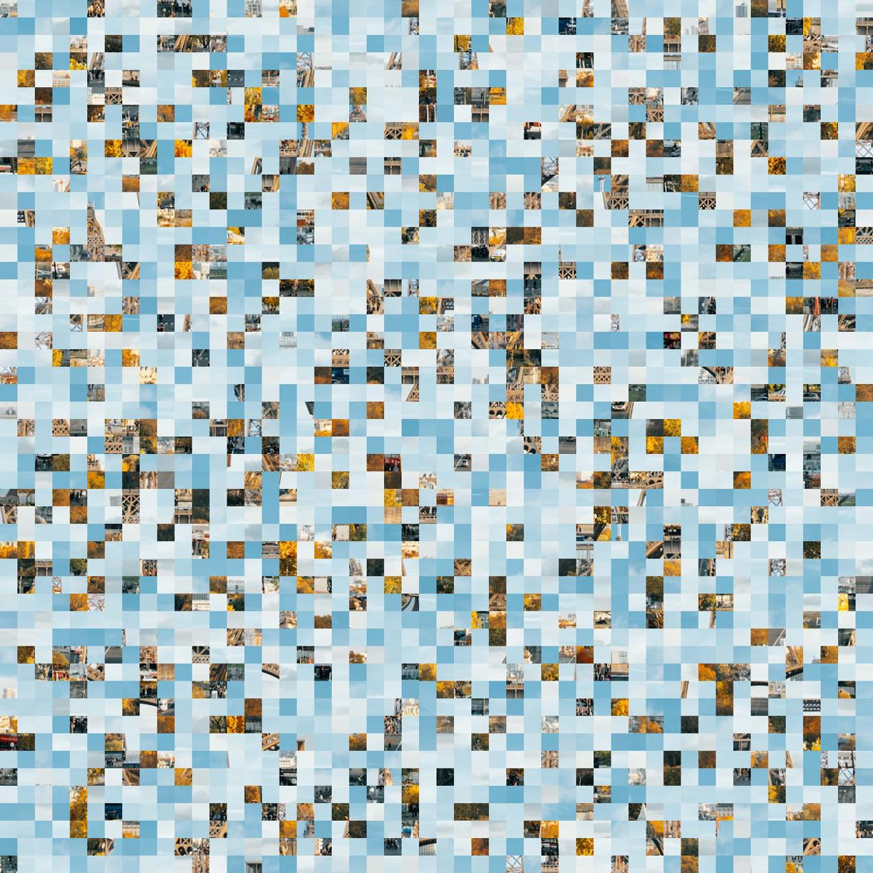
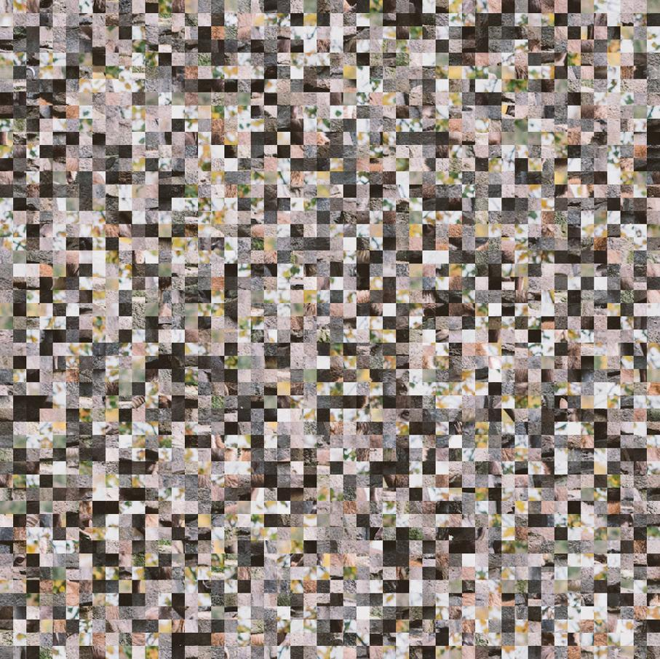
In between the decision pairs, we will also show you pairs of scrambled images.
When you observe a scrambled pair, you are asked to wait until an arrow comes up. When it does, select the scramble image the arrow is pointing at as soon as you can (“D” key for left <=, “K” key for right =>).
See example below.
<=
+

Slide 13
Outcome learning

Slide 14
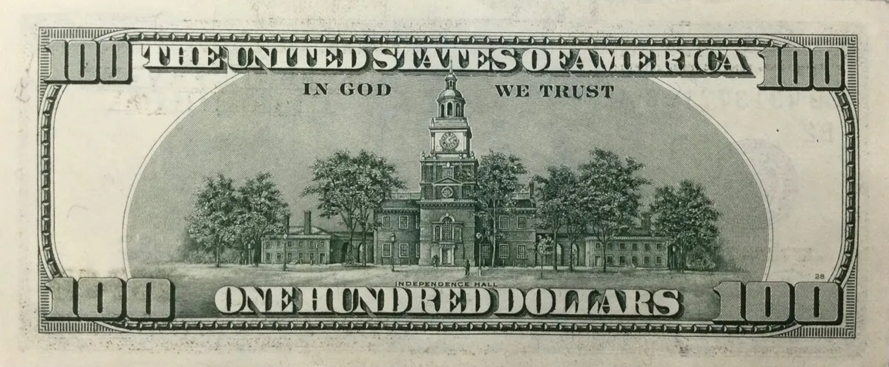
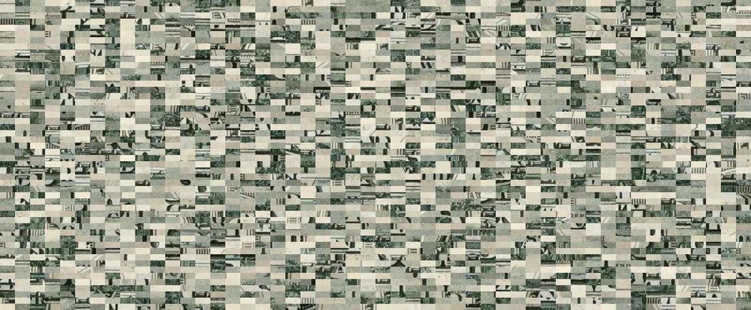
Are you ready to find out how well your selected photographs did at the auction?
We will show you whether each photograph you chose was sold with a
GAIN (sold higher than the price you paid for it – signaled by the $100 bill),
or with NO GAIN (no earnings, signaled by the scrambled image).
GAIN
NO GAIN
+
+
+
+

Slide 15
We will also tell you at the end of this phase whether you earned bonus payment from your decisions (remember, one of those will be played out for real earning).
Later in the experiment, this information will help you earn more bonus money.
GAIN
NO GAIN
+
+
+
+

Slide 16
To help you learn better, we will present the outcomes for your selected photographs several times.
In addition, we ask that you register the outcome by responding while the outcome is shown: If the outcome is a GAIN, press the “D” key. If it is a NO GAIN, press the “K” key.
You will have 1.5 seconds to respond. If you do not respond on time, you will see “TOO SLOW” on the screen.
GAIN
NO GAIN
+
+
+
+

Slide 17
Final decisions

Slide 18
Now that you are an expert art dealer, you are asked to prepare a portfolio of high-value photographs.
You will make a series of new choices among photographs. We will pay you additional bonus money based on your choices in this phase of the experiment.

Slide 19
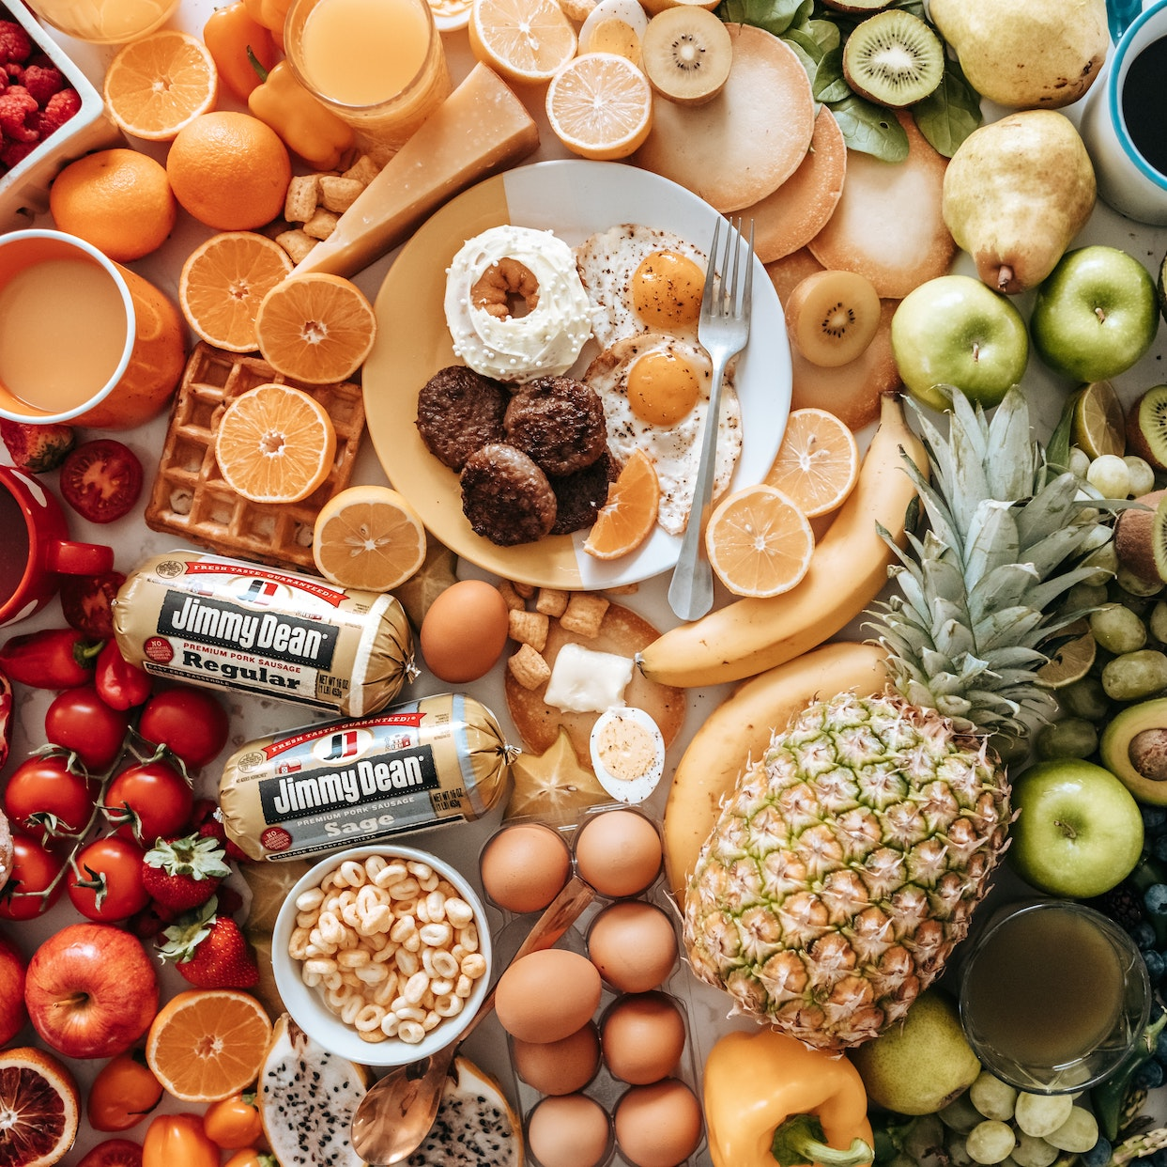
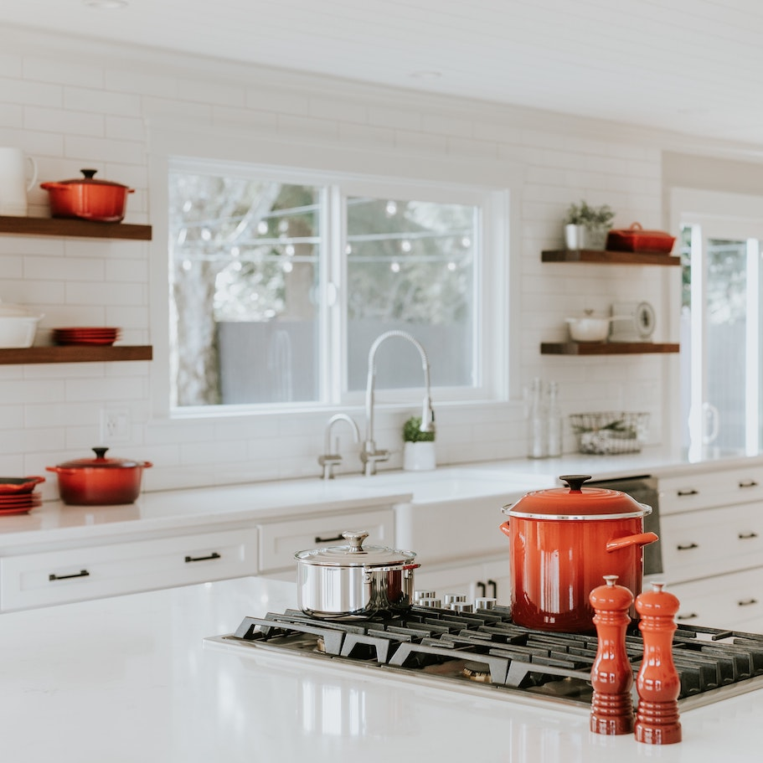
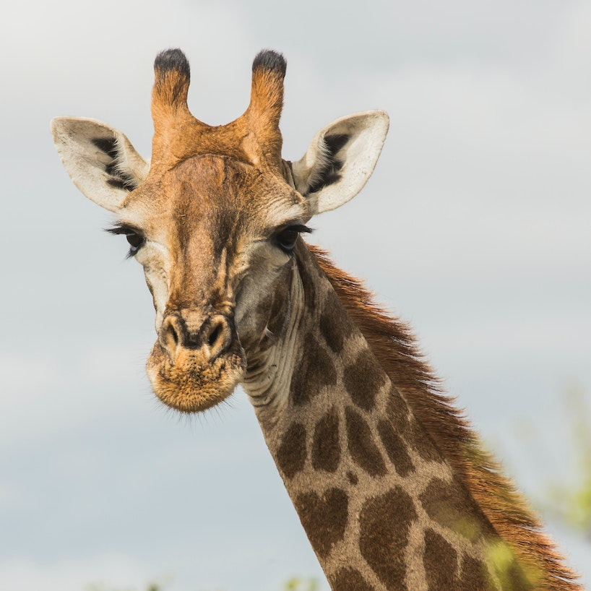

To choose the left photograph press the “D” key, to choose the right photograph press the “K” key.
You will have up to 1.5 seconds to make your choice.
If you do not respond during the allotted time, you will see “TOO SLOW” on the screen.
+
+

Slide 20
Memory

Slide 21
Let’s check what you remember from the beginning of the experiment where you had to decide which photograph should go on auction.
You will see pairs of photographs. Please tell us whether you already saw this exact pair in the beginning of the experiment (INTACT) or whether this is a recombined pair you have not seen before (RECOMBINED). Recombined pairs include photographs you have seen before, yet not in this unique pairing.

Slide 22
To indicate the pair is INTACT press the “D” key,
to indicate the pair is RECOMBINED press the “K” key.
You will have up to 1.5 seconds to respond.
If you do not respond during the allotted time, you will see “TOO SLOW” on the screen.
+
+
RECOMBINED
INTACT

Slide 23
Outcome estimation

Slide 24
Now we will ask you to tell us what the outcomes of the auction were.
In the beginning of the experiment, you chose photographs to go for auction and learned how much they profited. Later on, the remaining photographs (those you didn’t choose) also went on auction.
In this phase of the experiment, we will show you all the photographs you deliberated about (both those you chose and those you didn’t choose). For each photograph, please estimate whether it resulted in a GAIN or NO GAIN from the auction.

Slide 25
To estimate the photograph as a GAIN press the “D” key, to estimate the photograph as a NO GAIN press the “K” key.
You will have up to 1.5 seconds to make your choice.
If you do not respond during the allotted time, you will see “TOO SLOW” on the screen.
+
+
NO GAIN
GAIN

Slide 26
Final ratings

Slide 27
Before the experiment ends, we will ask you to rate photographs and scrambled images according to how much you like them.
Please use the mouse to indicate your rating, as shown below.
Not at all
Very much
How much do you like this photograph?
Continue

Slide 28
You will now take a short quiz to make sure you understood the instructions.

